Slide 1
Welcome to Author Talk
With Kevin Patrick Kenealy!

Slide 2
Trailer

Slide 3
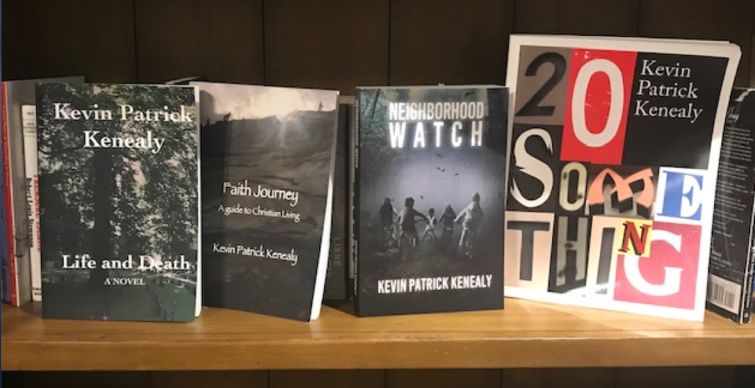
Where I get my ideas…
• Reading (Anything)
• Staying Alert to the World
• Asking Questions

Slide 4
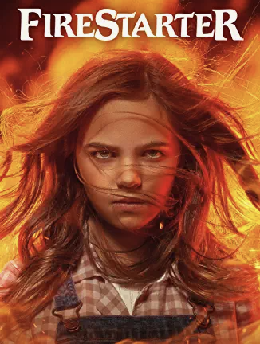
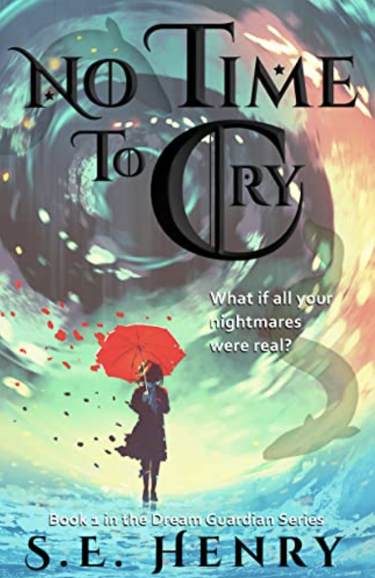
What are my favorite reads/what am I reading now?
• Favorite reads: Most anything by Stephen King - Firestarter, It, The Institute, Misery – a lot of these works inspired my books
• I enjoy good thrillers – Gillian Flynn, Liane Moriarty,
Celeste Ng, etc.
• I’ll read anything that holds my interest – I’m currently reading No Time to Cry…

Slide 5
What’s good writing advice?
You write your first draft with your heart and you re-write with your head. The first key is to write, not to think. – Finding Forrester

Slide 6
The Difference with editing
6/6/20 – First comments back
in lieu of dialogue, I'd tighten up the writing to ensure a smooth flow of thought, using active voice. That'll crisp it up some. Hope that helps!
12/29/20
Hi, Kevin! Flesh out the entire scene more. Some thoughts: What are the reactions of these boys to Jimmy's predicament? Did any of them remember that Jimmy was afraid of the water? How do they help Jimmy?

Slide 7
The difference with drafting…
3/13/21
To your questions….I abhor the word 'chick.' Are girls hens? Did Stella not teach them how to respect girls? Frankly, she doesn't serve a plot point enough to make her worthwhile. 376& l think you mishandled blank scene. I think you should rewrite the scene as realistic. Not 'dramatic effect'. 2020- Last page: No, actually, l was referring to not wrapping of other character's stories (see questions). It's a weak ending, frankly. Take some time with creating a lasting and haunting impression of this town.

Slide 8
Extra Newspaper Critiques
5/9/20 -
So, I approached this on how I would edit a paper. That said, obviously, you've got some artistic license to make things work best for your story. Newspapers do editorialize sometimes. They do get things wrong. And if you've got a number of publications, you might want to have differences in how they approach things, but if you're looking for good clean copy, I offered recommendations approaching it from that mindset. But let me know if you have questions, and good luck with the rest of the book.
-Bill Jones, former editor and chief of Orland Park Prairie

Slide 9
What I did last…
Hey, Kevin! I've finished the changes and the general formatting. Am having a challenge with headers and footers, but l'd be happy to send what l have if it's enough for you to look over now. Cleaned up a bunch of things and I think it looks good as a book.
Then…run it through Grammarly, order an author copy, read it one more time in print

Slide 10
Was I done Yet?
Nope! Sent out query letters to several publishers, waited on replies – when I heard rejected after rejection, I believed in myself and self published. I must have had something because the reviews per the trailer speak for themselves.
Finally, in 2/14/22 it was published by summer, it is appearing in libraries and in a local bookstore (Centuries & Sleuths in Forest Park). I hope to keep expanding as well.

Slide 11
My bloG
I post news updates and write fairly regularly on my blog at www.kevinpatrickkenealy.com. You can find anything on there about reading and writing tips, short stories, random reactions to the news, pop culture stories, and white sox follow-ups.
Also, follow me on Facebook at www.facebook.com/kevinpatrickkenealy or on twitter at twitter.com/kevinkenealy. I have a Goodreads page too and an Instagram.

Slide 12
What’s next
I’m hoping to release my next novel, Crash and Burn, next year. There is actually a preview of it in the Neighborhood Watch Illustrated edition. The synopsis for that book is below.
While her house burns, Emily Murphy’s baby, Danny, goes missing. The kidnapper, it turns out, is none other than her husband, Jack. Emily hires Detective Paul Walden to hunt down her husband and retrieve her child. As the case progresses, we see how Emily’s emotionally unstable life without her son begins crashing and burning. Meanwhile, not all of the facts of the case may be entirely accurate, as Jack later shares his story on what really happened the night of the kidnapping.

Slide 13
Where can you get my books?
Amazon and other select online retailers
Centuries & Sleuths Bookstores
Future Book signings – pay attention to news on my website

Slide 14
Neighborhood Watch Formats
Audiobook
Ebook
Paperback
Hardcover – Illustrated Version
Link for all versions is on Amazon

Slide 15
Anything Else?
I am always working on something. Crash and Burn is currently in the editing stages, so I am working on a book about writing, as well as re-editing my first novel, Life and Death. I would like to re-release that with a new cover. People have asked me about a sequel to that and to Neighborhood Watch. Eventually, that will probably happen. I also have a long list of short stories I compiled last year that I am waiting to do something with.

Slide 16
Questions?
There is so much more I have not talked about – how to get book reviews, learning about marketing, how to self publish, how to devote time to writing, etc. Just ask away!

